Slide 2
2016 Construction & Materials Specifications
Performance Specification 611

Slide 3
Item 611 Specification
Fall of 2015 SS800 & 2016 Book
611.04 Installation Plans require CA-P-1A and CA-P-3A – Becomes part of the Contract
Cross-sections & manufacturer sign off still required

Slide 4
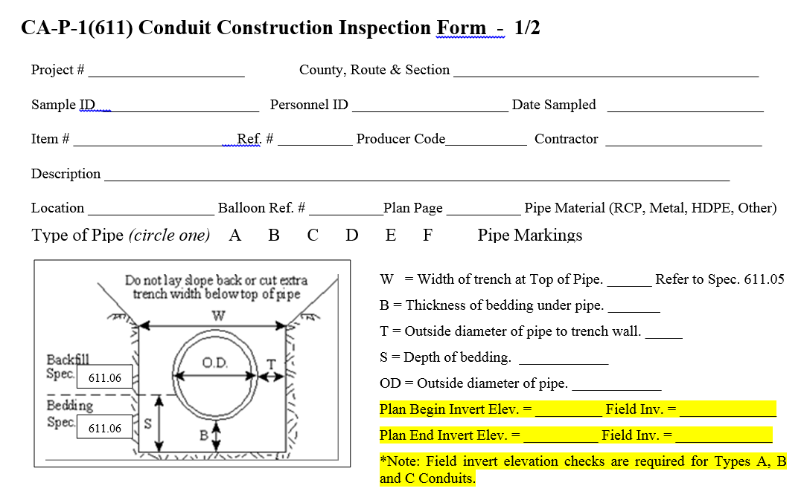
Item 611 Specification
Fall of 2015 SS800 & 2016 Book
611.04 Construction Inspections require CA-P-1 and CA-P-3
Verification of as-built elevations
Formerly part of performance survey
Out of tolerance construction requires evaluation – Contractor’s risk

Slide 5
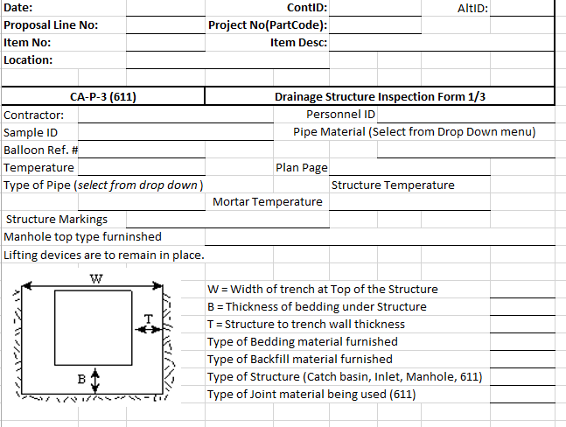
Item 611 Specification
Fall of 2015 SS800 & 2016 Book
CA-P-3 not required for precast concrete outlet structures

Slide 6
Item 611 Specification
Fall of 2015 SS800 & 2016 Book
611.13 Conduit Evaluation
Engineer must document all defects and provide evaluation.
Table 611.13 and LRFD Bridge Construction Specification Sections 26, 27 & 30
Metal conduits – racking is to be measured on structural plate conduits
Concrete conduits – cracks are to be evaluated at 0.01-in
Thermoplastic conduits – flattening or racking at installation

Slide 7
Item 611 Specification
Fall of 2015 SS800 & 2016 Book
611.13 Conduit Evaluation
Evaluate defects for structural stability & hydraulic capacity
Hydraulic analysis intended for out of tolerance installations
Repairs require follow-up inspection and evaluation - 30-90 day waiting period applies

Slide 8
Item 611 Specification
Fall of 2015 SS800 & 2016 Book
Table 611.13
Evaluate vertical alignments from CA-P-1
Sags require hydraulic and structural evaluation
Joint gaps 100% within manufacturer’s tolerance
Cap repairs of flexible conduits at 12%
Deflections exceeding 7.5% require further measurements

Slide 9
Item 611 Specification
Fall of 2015 SS800 & 2016 Book
611.14 Drainage Structure Evaluation
Added similar language to 611.13
Table 611.14
Inspect construction and connections, not just infiltration
Invert elevation of connected conduits ref. CA-P-1
Grate elevation ref. CA-P-3

Slide 10
Item 611 Specification
Inspections and Evaluations

Slide 11
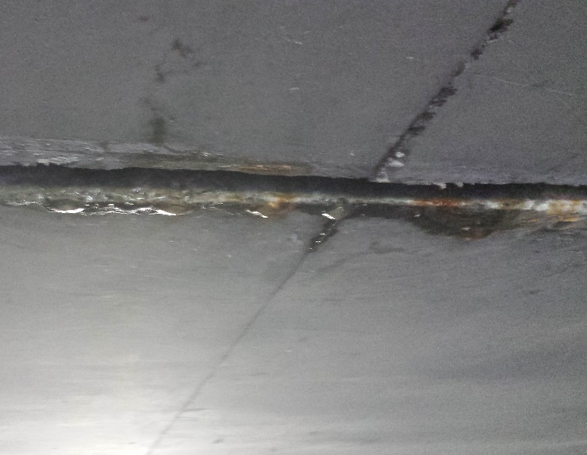
Item 611 Specification
Inspections and Evaluations

Slide 12
Item 611 Specification
Inspections and Evaluations

Slide 13
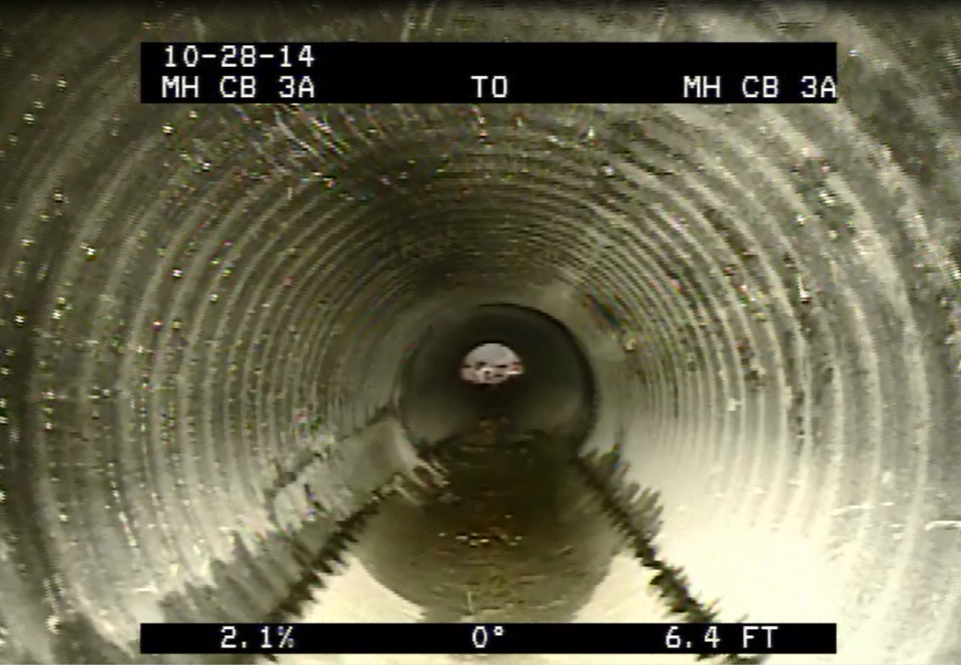
Item 611 Specification
Inspections and Evaluations

Slide 14
Item 611 Specification
Inspections and Evaluations

Slide 15
Item 611 Specification
Inspections and Evaluations

Slide 16
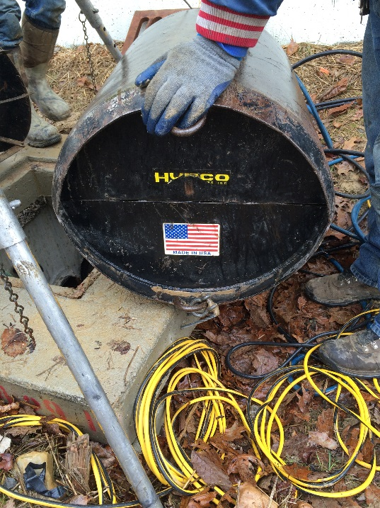
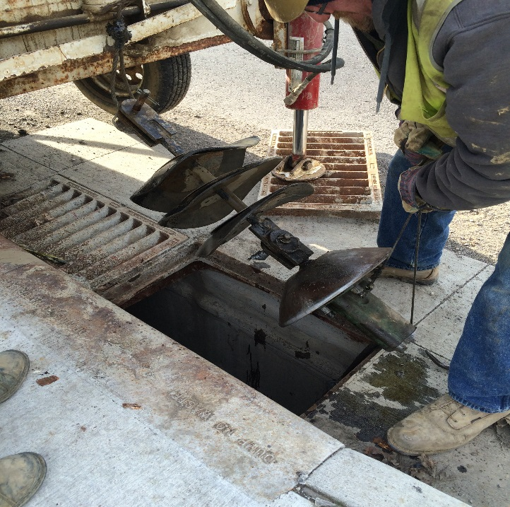
Item 611 Specification
Rerounding Repairs

Slide 17
Item 611 Specification
Rerounding Repairs

Slide 18
Panel Discussion
Ted Wellman, The Beaver Excavating Company
Greg Hamilton, Kokosing Construction Company
Mike Murphy, ODOT District 1 Area Engineer
Hans Gucker, ODOT Central Office Construction Administration

